Slide 1

Project Title AI-Powered Personalized Tutor System
Rajesh Maity

Slide 2

01
Introduction to the System
02
Objectives of the Project
03
System Components
/CONTENT/
04
Methodology
05
Technologies Utilized
06
Results and Future Developments

Slide 3
1 Introduction to the System
01
/

Slide 4
Overview of the Tutor System
Purpose of the system
Importance of personalization
Role of AI and ML in education
01
02
03
The AI-Powered Personalized Tutor System aims to create a customized educational experience by leveraging artificial intelligence to analyze individual learning habits and needs. This helps provide tailored recommendations for courses and study materials that suit each student.
Personalization in education significantly enhances learning outcomes by accommodating diverse learner preferences and paces. This system ensures that students receive support aligned with their unique strengths and weaknesses, which can increase motivation and engagement.
Artificial Intelligence (AI) and Machine Learning (ML) play a transformative role in education by enabling the analysis of vast amounts of data to derive insights that facilitate personalized learning. These technologies help in predicting student performance, recommending resources, and adjusting instructional strategies in real-time.

Slide 5
Objectives of the Project
02
/

Slide 6



Key Goals
01
02
03
Intelligent adaptation to learning styles
Accurate assessment forecasting
Dynamic course recommendations
The primary objective is to create a system that intelligently learns from students' interactions and adapts accordingly. This includes modifying instructional methods and materials based on real-time monitoring of student engagement and performance.
By building predictive models that analyze historical performance data, the system aims to offer reliable forecasts of student assessment scores, allowing educators to intervene proactively.
The system focuses on providing dynamic course recommendations based on the individual interests and performance levels of students, ensuring they engage with materials that both challenge and resonate with them.

Slide 7
System Components
03
/

Slide 8
Assessment Score Prediction
Parameters for score prediction
The prediction module integrates various student attributes including age, gender, parental occupation, study habits, and IQ levels. This multifactorial approach ensures a comprehensive assessment of potential academic performance.
01
Machine learning algorithms utilized
A range of machine learning algorithms, tailored to analyze historical data, are employed to enhance the accuracy of score predictions. These algorithms continuously improve their predictive capabilities through ongoing learning.
02
Importance of historical data
03
Historical student performance data serves as the foundation for making accurate score predictions. This data provides insights into trends, informed by past performance, thereby ensuring tailored predictions for future assessments.

Slide 9
Student Promotion Prediction
Factors influencing promotion
01
The promotion prediction module examines various factors like assessment scores, course difficulty, and individual study habits. These considerations result in a well-rounded approach to determining a student’s eligibility for promotion.
02
Recommendation effectiveness
By evaluating numerous attributes surrounding student performance, the system delivers highly effective recommendations on promotion eligibility, ensuring that decisions are equitable and data-driven.
03
Use of performance indicators
Performance indicators help gauge a student’s readiness for advancement, providing concrete metrics that educators can rely on to assess overall academic growth and future potential.

Slide 10



Course Recommendation System
NLP in course processing
Techniques: TF-IDF and cosine similarity
Filtering based on user preferences
Natural Language Processing (NLP) is employed to analyze course descriptions and identify the most relevant materials for students. This technology enables nuanced comprehension of course content and alignment with student needs.
The system utilizes techniques like TF-IDF vectorization and cosine similarity to measure the relevance of course content against user needs, ensuring that suggested courses are optimally aligned with student preferences.
Suggested courses are filtered through user-defined criteria including difficulty levels and personal interests, ensuring students receive only the most pertinent course options that meet their educational goals.

Slide 11
Methodology
04
/

Slide 12

Data Collection Processes
Importance of data quality
The quality of the data collected is paramount, as accurate predictions and recommendations are contingent on the reliability of the historical student performance information gathered.
Sources of student performance data
Data was collected from a variety of educational platforms, ensuring a rich dataset that reflects a wide range of student experiences and outcomes.

Slide 13


Implementation and Testing
02
01
03
Backend and frontend technologies
System architecture overview
Evaluation through user feedback
User feedback played a critical role in evaluating the effectiveness and usability of the AI tutor system, guiding improvements and refinements based on actual student and educator experiences.
The system is designed with a robust architecture that separates the backend functionalities from the frontend user interface, ensuring a smooth interaction for users.
A combination of Streamlit for the backend and HTML, CSS, for the frontend facilitates a responsive and efficient web-based application, enhancing user experience and interaction

Slide 14
Technologies Utilized
05
/

Slide 15

Programming Languages
Python for system development
Python serves as the primary programming language for system development due to its versatility and extensive library support, particularly in data analysis and machine learning.

Slide 16

Frameworks and Libraries
Overview of Streamlit
Streamlit is leveraged for developing the user interface, allowing for interactive, real-time visualizations that enhance user engagement with the learning system.
Key libraries: NumPy, Pandas, etc.
Essential libraries such as NumPy for numerical computations and Pandas for data manipulation empower the system to handle complex data analysis tasks efficiently.

Slide 17
Machine Learning Tools
Scikit-Learn for model training
NLTK for NLP functionalities
Scikit-Learn is utilized for training various machine learning models, offering a robust set of tools for implementing predictions and analytics within the education framework.
The Natural Language Toolkit (NLTK) is incorporated to perform complex NLP tasks, enabling effective processing of language data for course recommendations and analysis.

Slide 18
Results and Future Developments
06
/

Slide 19
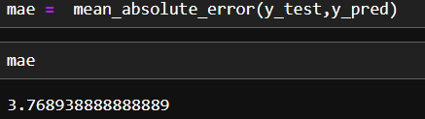
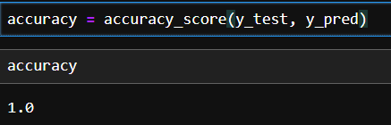
Achievements of the Project
Accuracy of score Assessment
Accuracy of Promotion
Accuracy of Course Recommendation
Model – Random Forest Regression
Matrix –r2_score, mean_absolute_error
Result –
Model – RandomForestClassifier
Matrix – accuracy_score, classification_report, confusion_matrix
Result –
Model-TF-IDF Vectorizer with Cosine Similarity
01
02
03

Slide 20
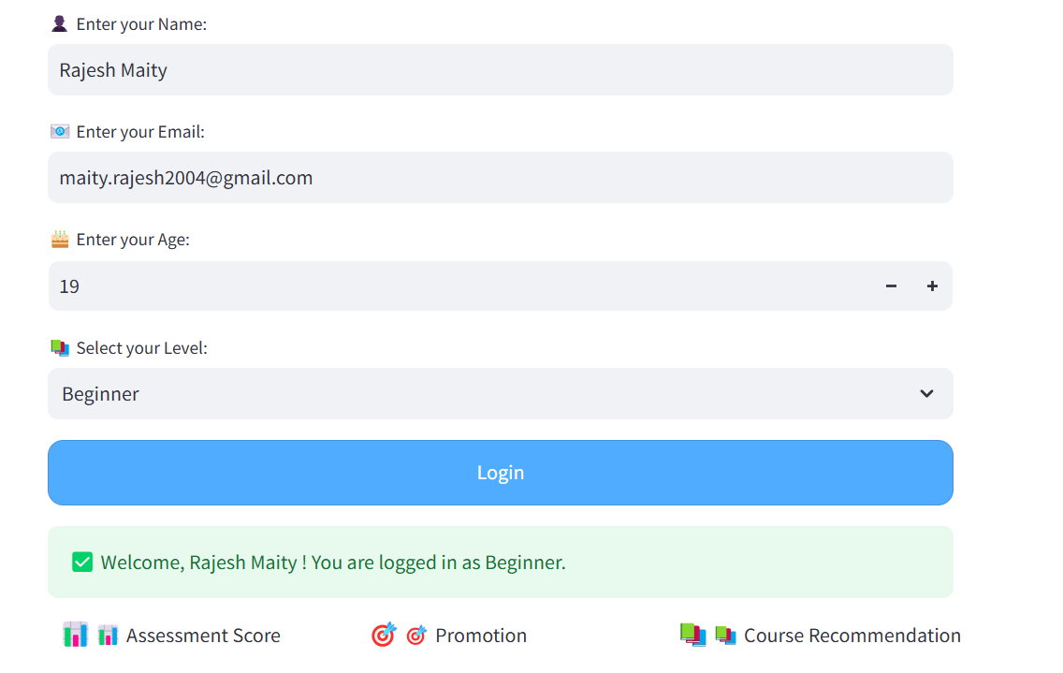
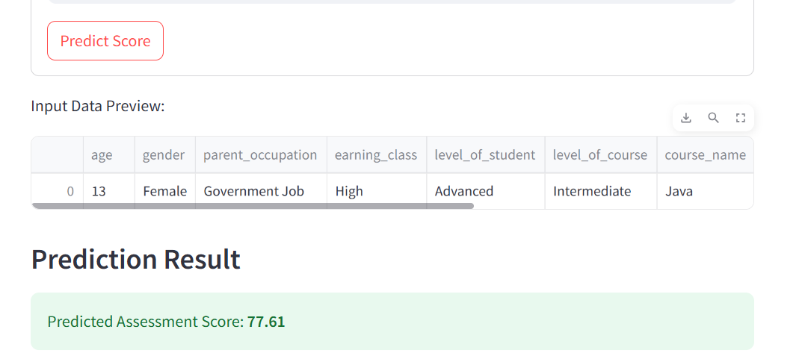



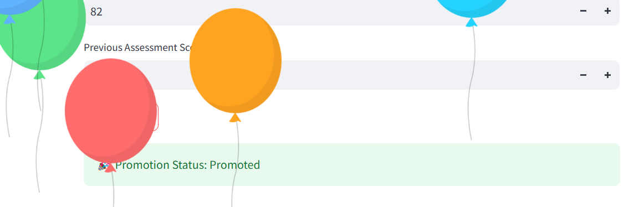

Flow Chart And Diagram

Slide 21
CONCLUSION
The AI tutor system showcases the power of AI in education through its ability to deliver customized learning experiences. Future development can involve adding Natural Language Processing (NLP) for interactive tutoring, widening the dataset to make more accurate predictions, and adding real-time feedback mechanisms to improve student participation.

Slide 22
Thank You

